Slide 1

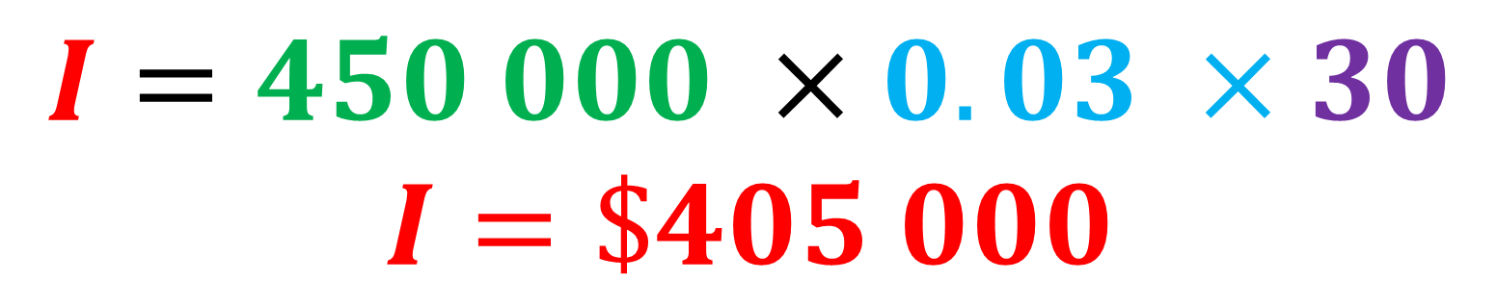

Daily Review
$$I=PrT$$
CFU 1
What is the principal?
Calculate the simple interest payable on a loan of $450 000 at a rate of 3% p.a for 30 years.
Calculate how much is paid back in total.
CFU 2
What is the interest rate?
CFU 3
What is the time period?
P = $450 000
r = 3% = 0.03
T = 30 years
CFU 4
How much interest is paid/owed?
$$I=450 000 ×0.03 ×30$$
$$I=\$405 000$$
CFU 5
How much is paid in total?
$$450 000+ 405 000=\$855 000$$

Slide 2
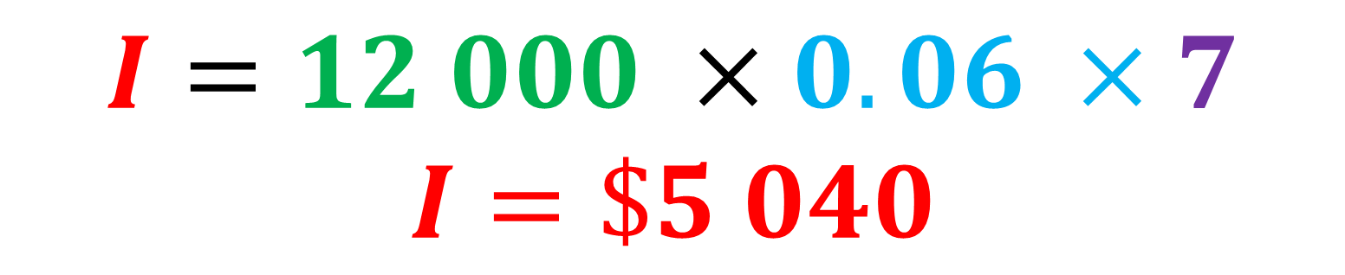
Daily Review
$$I=PrT$$
CFU 1
What is the principal?
Calculate the simple interest owed if you invest $12 000 at a rate of 6% p.a for 7 years.
Calculate how much is paid back in total.
CFU 2
What is the interest rate?
CFU 3
What is the time period?
P = $12 000
r = 6% = 0.06
T = 7 years
CFU 4
How much interest is paid/owed?
$$I=12 000 ×0.06 ×7$$
$$I=\$5 040$$
CFU 5
How much is paid in total?
$$12 000+ 5 040=\$17 040$$

Slide 3
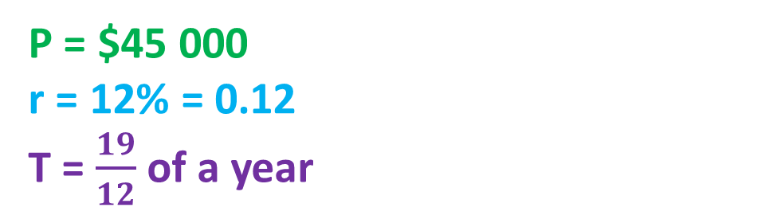
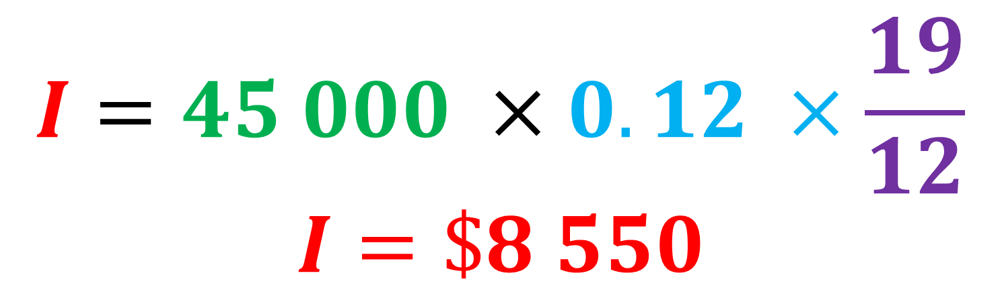
Daily Review
$$I=PrT$$
CFU 1
What is the principal?
Calculate the simple interest payable on a loan of $45 000 at a rate of 12% p.a for 19 months.
Calculate how much is paid back in total.
CFU 2
What is the interest rate?
CFU 3
What is the time period?
P = $45 000
r = 12% = 0.12
T = $\frac{19}{12}$ of a year
CFU 4
How much interest is paid/owed?
$$I=45 000 ×0.12 ×\frac{19}{12}$$
$$I=\$8 550$$
CFU 5
How much is paid in total?
$$45 000+8 550=\$53 550$$

Slide 4

Concept Development
VOCABULARY
Principal – the original amount of money borrowed or invested Interest – the additional amount paid or earned Simple interest – interest calculated on the original amount only
There are lots of different ways that interest can be calculated.
Simple interest is calculated on the original amount borrowed or invested and is not affected by how much that amount changes over time.
The amount of simple interest (I) paid or earned depends on:
The principal (P), the original amount of money borrowed or invested.
The interest rate (r) that is charged or paid (in decimal or fraction)
The time period (T) for which the money is borrowed or invested (in years).
$$I=PrT$$
Simple interest = original amount (principal) x interest rate x time period

Slide 5
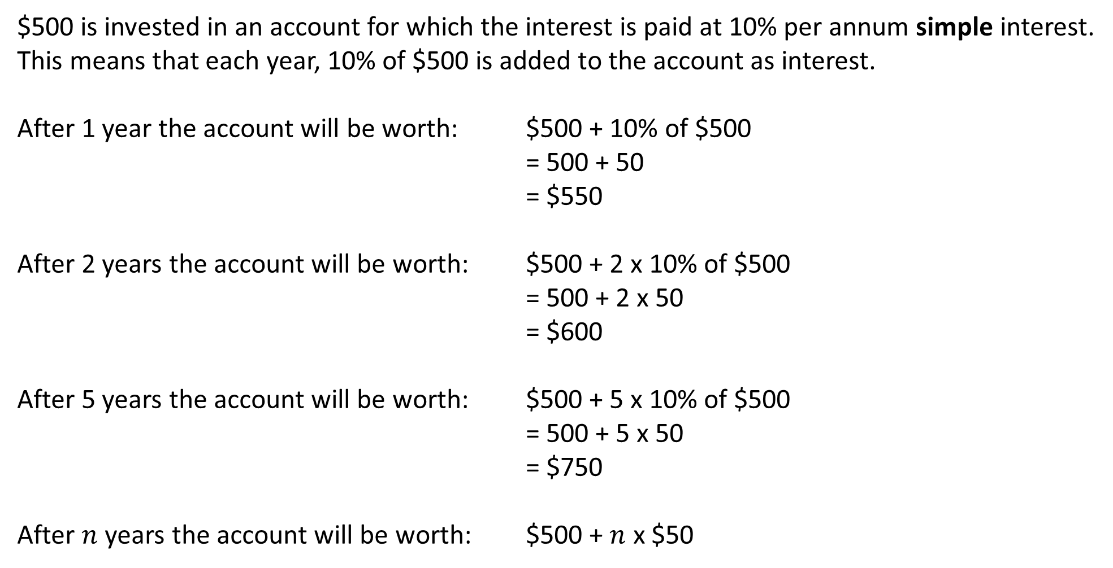
Y11 Apps Chapter 3 Situation 1
$500 is invested in an account for which the interest is paid at 10% per annum simple interest.
This means that each year, 10% of $500 is added to the account as interest.
After 1 year the account will be worth: $500 + 10% of $500
= 500 + 50
= $550
After 2 years the account will be worth: $500 + 2 x 10% of $500
= 500 + 2 x 50
= $600
After 5 years the account will be worth: $500 + 5 x 10% of $500
= 500 + 5 x 50
= $750
After $n$ years the account will be worth: $500 + $n$ x $50

Slide 6
Y11 Apps Chapter 3 Example 1
Determine the interest paid on $2500 invested at 8% per annum simple interest for 3 years.
How much is the investment worth at the end of the three years?
After 3 years the account will be worth: $2500 + 3 x 8% of $2500
= 2500 + 3 x 0.08 x 2500
= 2500 + 600
= 3100
After 3 years, the interest paid is $600.
The total investment is worth $2500 + $600.
The investment is now worth $3100.

Slide 7

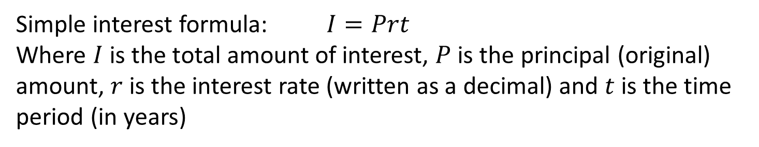
Y11 Apps Chapter 3 Example 2
Determine the interest paid on $8400 invested at 2.4% p.a. simple interest for 5 years.
Simple interest formula: $I=Prt$
Where $I$ is the total amount of interest, $P$ is the principal (original) amount, $r$ is the interest rate (written as a decimal) and $t$ is the time period (in years)
$$I = Prt$$
$$I =(8400)(0.024)(5)$$
$$I =1008$$
After 5 years, the interest paid is $1008.

Slide 8
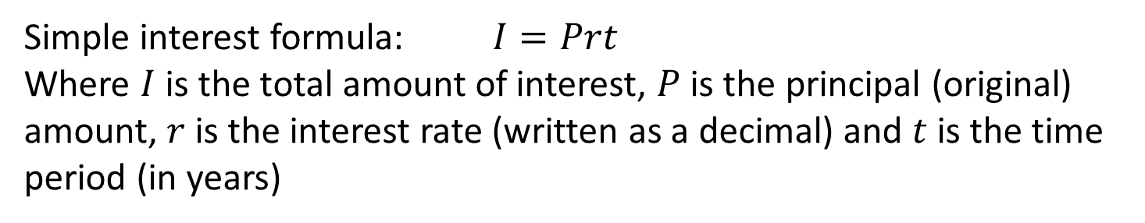
Y11 Apps Chapter 3 Example 3
Determine the value after 2 years of an investment of $75 000 invested at 4.6% p.a. simple interest.
Simple interest formula: $I=Prt$
Where $I$ is the total amount of interest, $P$ is the principal (original) amount, $r$ is the interest rate (written as a decimal) and $t$ is the time period (in years)
$$I = Prt$$
$$I =(75 000)(0.046)(2)$$
$$I =6900$$
After 2 years, the interest paid is $6900.
The total investment is worth $75 000 + $6900.
The investment is now worth $81 900.

Slide 9
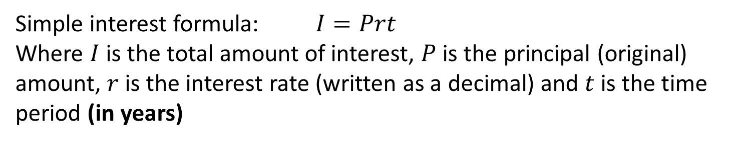
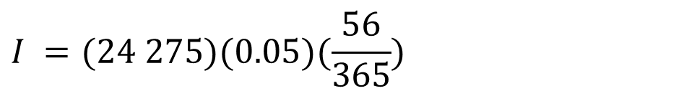
Y11 Apps Chapter 3 Example 4
How much interest is due after 56 days for an investment of $24 275 invested at 5% per annum? (Give your answer to the nearest cent).
Simple interest formula: $I=Prt$
Where $I$ is the total amount of interest, $P$ is the principal (original) amount, $r$ is the interest rate (written as a decimal) and $t$ is the time period (in years)
As the time period is given in days, we need to convert it to a fraction of a year before applying the formula.
There are 365 days in a year.
There are 52 weeks in a year.
There are 12 months in a year.
There are 4 quarters in a year.
$$I = Prt$$
$$I =(24 275)(0.05)(\frac{56}{365})$$
$$I =186.2192..$$
After 56 days, the interest due is $186.22.

Slide 10
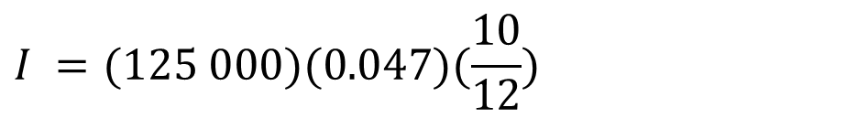
Y11 Apps Chapter 3 Example 5
Now do Exercise 3A
How much interest is due after 10 months for an investment of $125 000 invested at 4.7% per annum? (Give your answer to the nearest cent.)
Simple interest formula: $I=Prt$
Where $I$ is the total amount of interest, $P$ is the principal (original) amount, $r$ is the interest rate (written as a decimal) and $t$ is the time period (in years)
As the time period is given in months, we need to convert it to a fraction of a year before applying the formula.
There are 365 days in a year.
There are 52 weeks in a year.
There are 12 months in a year.
There are 4 quarters in a year.
$$I = Prt$$
$$I =(125 000)(0.047)(\frac{10}{12})$$
$$I =4895.8333….$$
After 10 months, the interest due is $4895.33.

Slide 11
Y11 Apps Chapter 3 Example 6
Now do Exercise 3C
How much needs to be repaid after three years to repay a loan of $8000 at 5.4% per annum simple interest?
Simple interest formula: $I=Prt$
Where $I$ is the total amount of interest, $P$ is the principal (original) amount, $r$ is the interest rate (written as a decimal) and $t$ is the time period (in years)
$$I = Prt$$
$$I =(8000)(0.054)(3)$$
$$I =1296$$
After 2 years, the interest owed is $1296.
The total amount owed is $8000 + $1296.
$9296 needs to be repaid after three years.

Slide 12
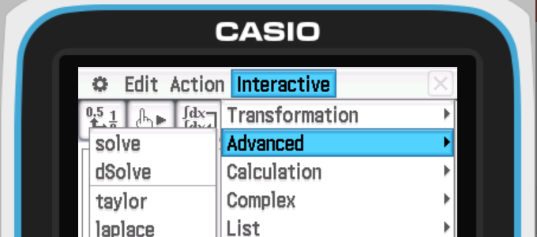
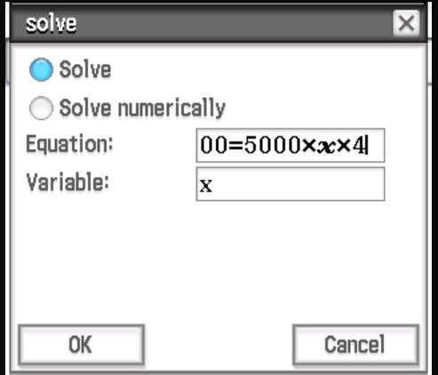
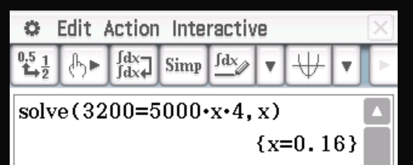
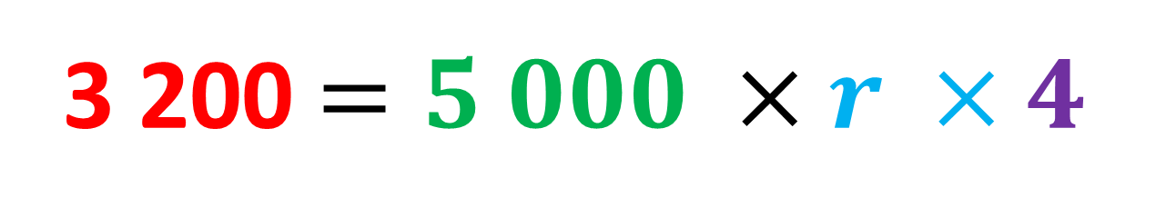

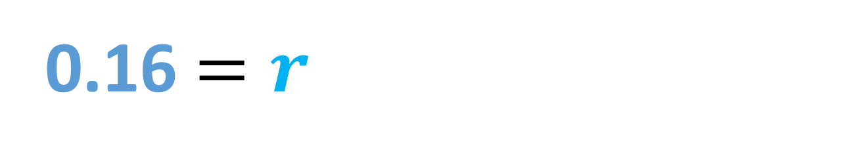
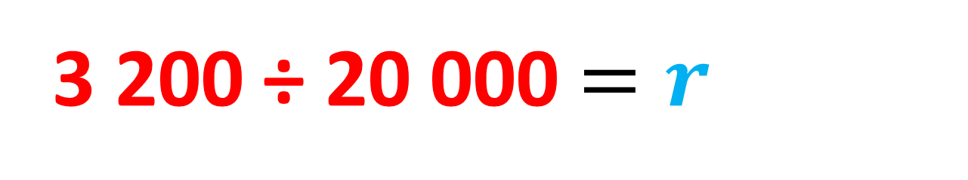
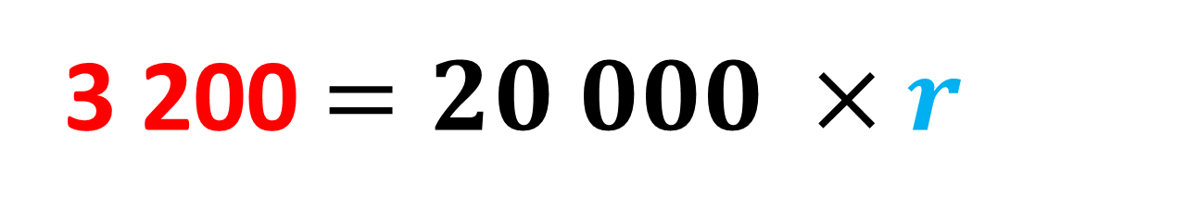
Y11 Apps Chapter 3 Example 7
The simple interest paid on a loan of $5 000 over 4 years was $3 200. What interest rate was offered?
p. a. means per annum, or yearly
I = $3 200
P = $5 000
r = ??
T = 4 years
$$I=PrT$$
3 200$=5 000 ×r ×4$
3 200 $=20 000 ×r$
3 200 ÷ 20 000$=r$
0.16 $=r$
Therefore, the interest rate offered on the loan was 16% p.a

Slide 13
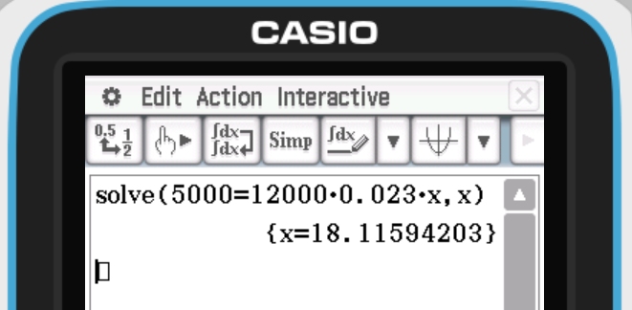
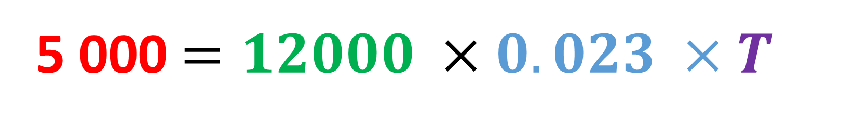

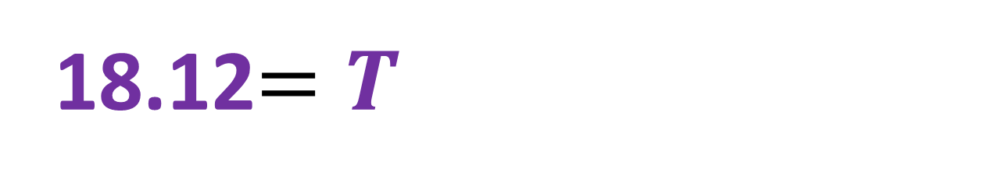


Y11 Apps Chapter 3 Example 8
How long would an investment of $12 000 need to be left to earn $5 000 at an interest rate of 2.3%p.a?
p. a. means per annum, or yearly
I= $5 000
P = $12 000
r = 0.023
T = ??
$$I=PrT$$
5 000$=12000 ×0.023 ×T$
5 000 $=276 ×T$
5 000 ÷ 276$=T$
18.12$=T$
Therefore, the loan would need to be left for 18.12 years

Slide 14
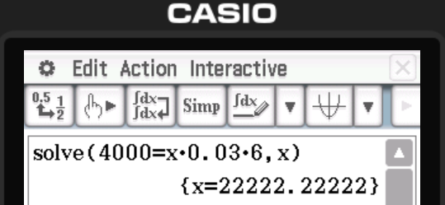


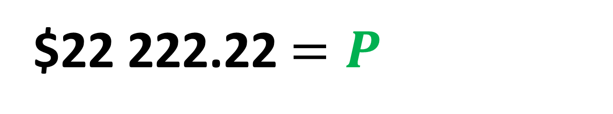


Y11 Apps Chapter 3 Example 9
What initial amount should be invested at 3%p.a to earn $4 000 interest over 6 years.
p. a. means per annum, or yearly
I= $4 000
P = ??
r = 0.03
T = 6
$$I=PrT$$
4 000 $=P ×0.03 ×6$
4 000$=P ×0.18$
4 000 ÷ 0.18 $=P$
$22 222.22$=P$
Therefore, $22 222.22 would need to be invested initially

